Slide 1
DDS Draft
Team Argus

Slide 2
Overview
Introduction
Architecture Overview
System Hardware Description
System Software Description
Detailed Design
PixelSense Superlayer
Tablet/Lynx Superlayer
Transfer Superlayer
Quality Assurance
Requirement Mapping
Acceptance Plan

Slide 3
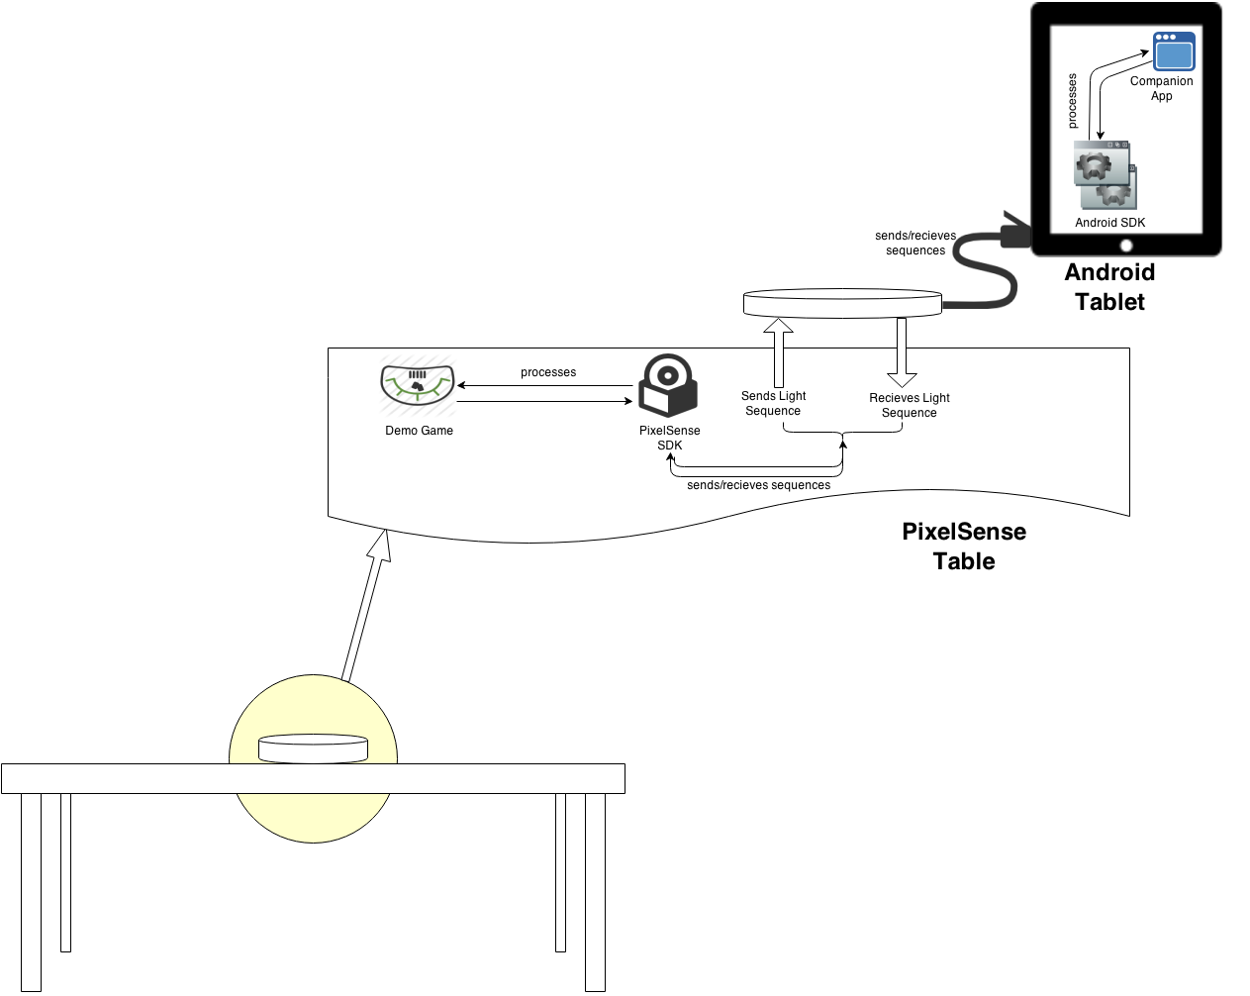
Introduction
Purpose and Use
Project Scope

Slide 4
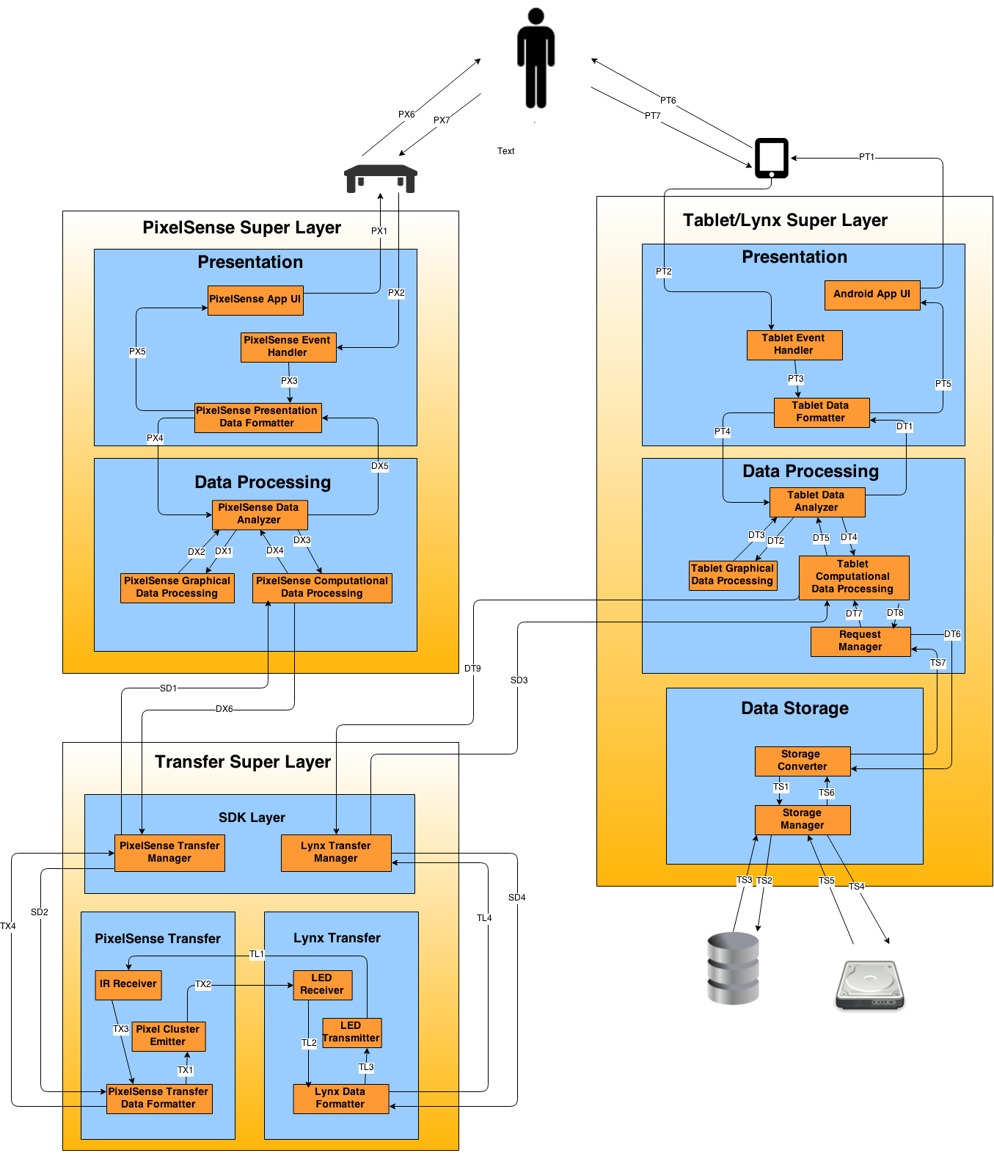
Architecture Overview

Slide 5
System Hardware Description
Hardware components our device is made up of
Hardware components used to operate our device
Additional hardware components that we may or may not use pending further research

Slide 6
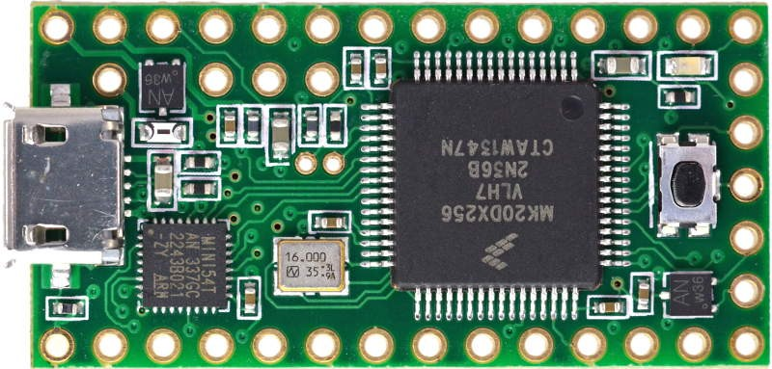
Arduino-based Microcontroller
Quantity: 1
Purpose: Main driver and processor for Lynx, controls input and output to tablet and connected LEDs and phototransistors
Interfaces:
To and from Android Tablet (USB)
Powers LEDs to send to table
Reads light from table using phototransistors

Slide 7
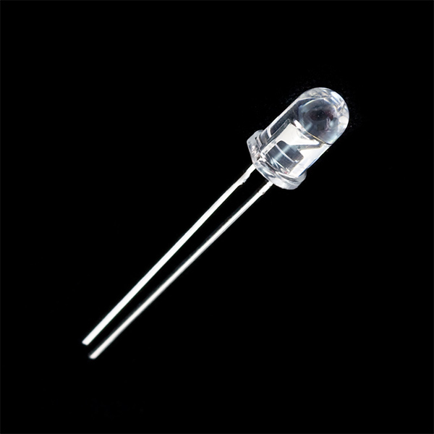
IR LEDS
Quantity: 16
Purpose: Send readable signals to PixelSense table in order to transfer data
Interfaces:
Receives power from the micro- controller
Send IR Light to be read by the PixelSense table

Slide 8
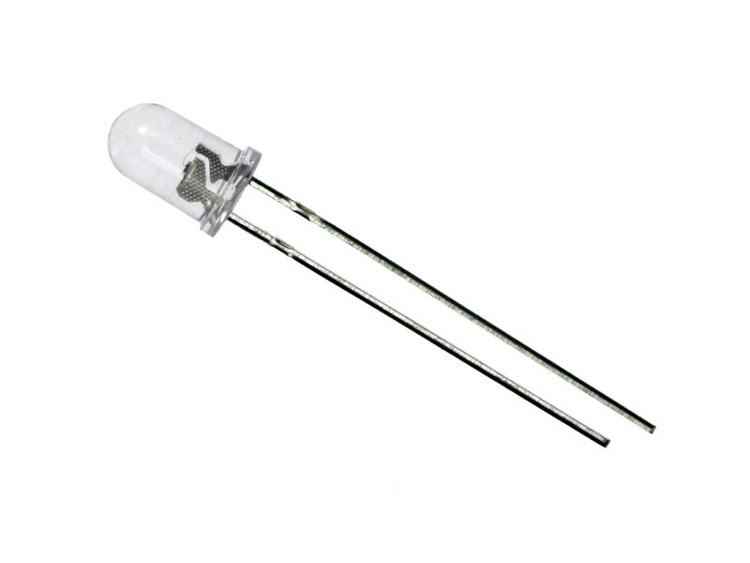
Visible Light Phototransistor
Quantity: 16
Purpose: Read light from PixelSense table
Interfaces:
Powered by microcontroller
Receives light from the PixelSense table
Send reading through input pin on the microcontroller via op amp

Slide 9
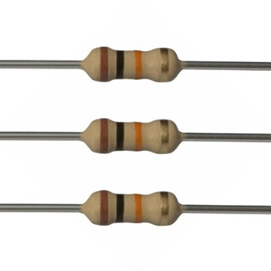
Resistors
Quantity: TBD
Purpose: Limit current going to electronic components, resistance values TBD
Interfaces:
Connected between electronic components

Slide 10
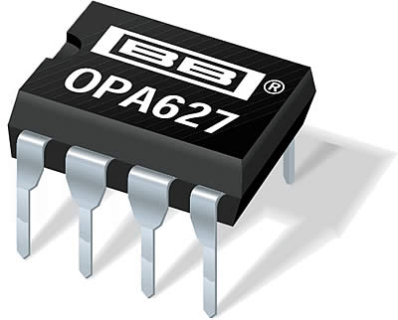
Op Amps
Quantity: TBD
Purpose: Amplifies voltage outputted by an electronic component.
Interfaces:
Receives input from phototransistor
Outputs to microcontroller

Slide 11
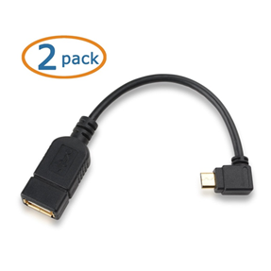
Micro-USB 2.0 On-The-Go (OTG) Adapter
Quantity: 1
Purpose: Allows a Male A USB cable to be plugged into the Micro USB port of the Android tablet
Interfaces:
Receives input from Micro USB port of the tablet
Outputs to USB Type A Female port (Cable connected to microcontroller)

Slide 12
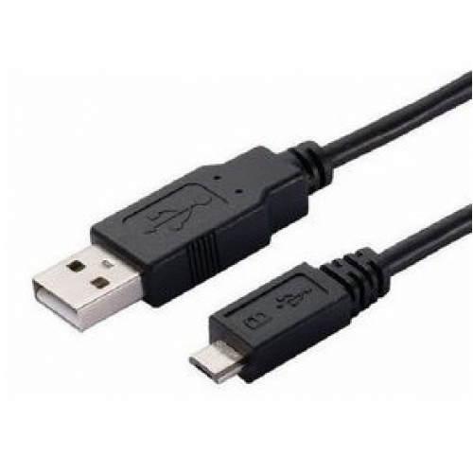
USB Cord
Quantity: 1
Purpose: Connects microcontroller to the adaptor connected to the Android tablet
Interfaces:
Sends and receives data to and from the connected Android tablet and microcontroller of the Lynx

Slide 13
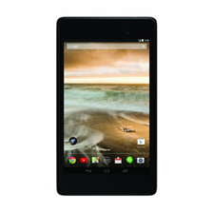
Android Tablet
Quantity: 1
Purpose: Provides an interface for the user to send, receive and modify data with the Lynx
Interfaces:
Receives input from the user via touch controls
Sends and receives data to and from the PixelSense table using the Lynx device connected to its Micro USB port

Slide 14
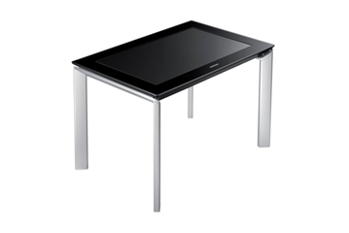
Samsung SUR40
Quantity: 1
Purpose: The Device we will be reading and sending data to. This device will be running our blackjack demonstration software
Interfaces:
Receives input from the user via touch controls
Receives IR light from the Lynx and converts that to data
Sends data in the form of visible light to the Lynx device

Slide 15
Additional Hardware (Tentative)
Shift and Counter Shift Registers
MicroSD Card and SD Card Shield

Slide 16
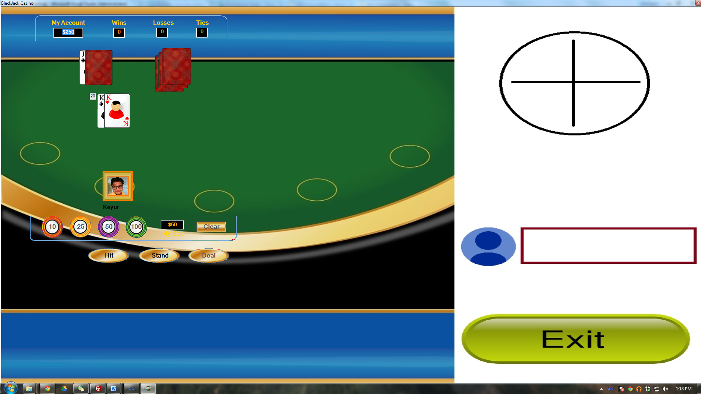
System Software Description
PixelSense Windows Application
BlackJack application to showcase
features in an environment.
Will receive data via the infrared
sensors within the table
Will send data by flashing specific
areas of the screen.

Slide 17





System Software Description
PixelSense Windows Application
Development tools
Visual Studio 2010
Windows 7 Professional
Libraries and Frameworks
PixelSense 2.0 SDK
Microsoft XNA Framework
Windows Presentation Framework

Slide 18

System Software Description
Android Application
BlackJack compliment application
Features data transfer between devices
Main end-user communication device.

Slide 19

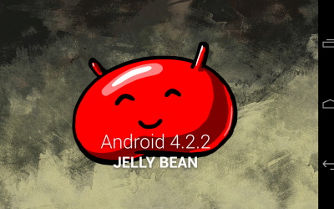

System Software Description
Android Application
Development tools
Android Studio
Libraries and Frameworks
Android SDK, API 17+ (4.2.2+)
OpenGL ES 2.0
External Communications Libraries (ie. HoHo Serial)

Slide 20

System Software Description
Arduino Sketch
Transfer program on multicontroller
Converter for light to binary
Based on C/C++ language with many microcontroller support.

Slide 21
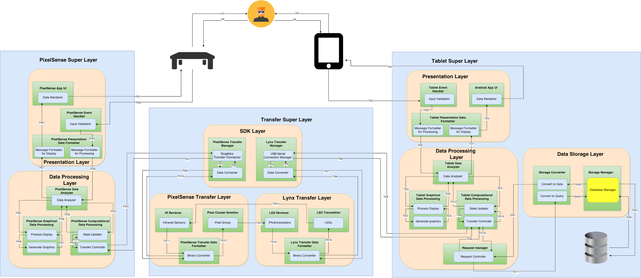
Module Decomposition Diagram

Slide 22
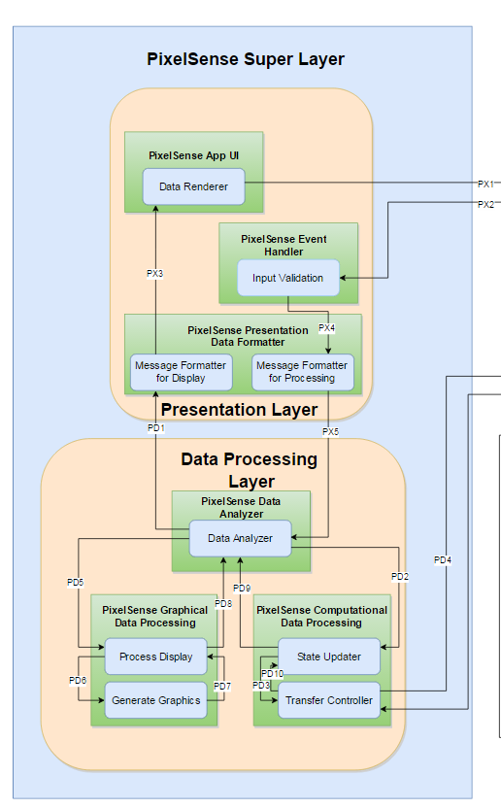
PixelSense Super Layer
Presentation Layer
PixelSense App UI
Data Renderer
PixelSense Event Handler
Input Validation
PixelSense Presentation Data Formatter
Message Formatter for Display
Message formatter for Processing
Data processing Layer
PixelSense Data Analyzer
Data Analyzer
PixelSense Graphical Data Processing
Process Display
Generate Graphics
PixelSense Computational Data Processing
State Updater
Transfer Controller

Slide 23
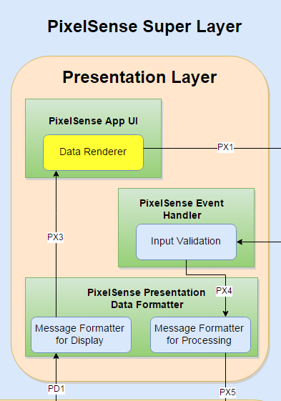
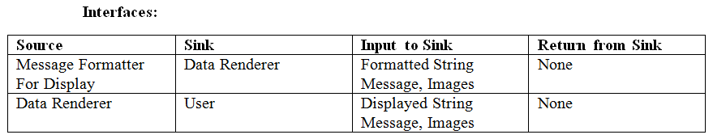
PixelSense Super Layer Modules
Presentation Layer
Data Renderer
Prologue: This module will render graphical as well as computational data content to PixelSense Table’s screen.

Slide 24
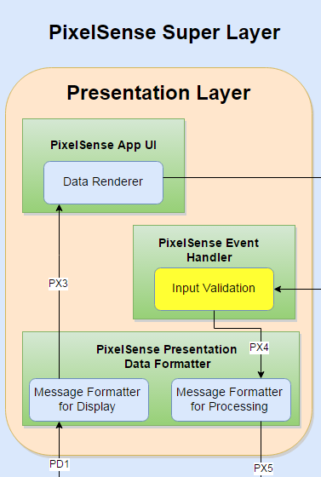
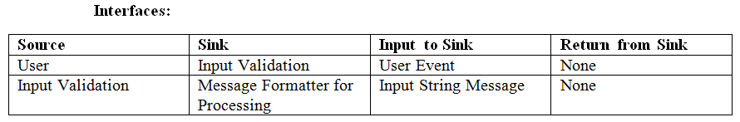
PixelSense Super Layer Modules
Presentation Layer
Input Validation
Prologue: Input Validation module is responsible for determining data type of the user input.

Slide 25
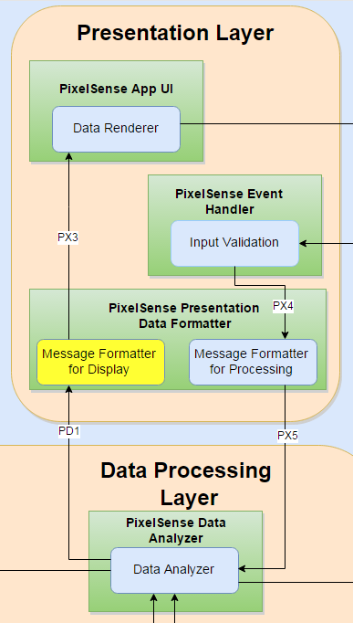
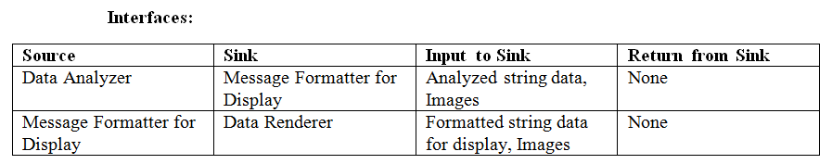
PixelSense Super Layer Modules
Presentation Layer
Message Formatter for Display
Prologue: Message Formatter for display module will accept the analyzed data from Data processing layer, and it will format the data in such a way that it is ready for display on the table.

Slide 26
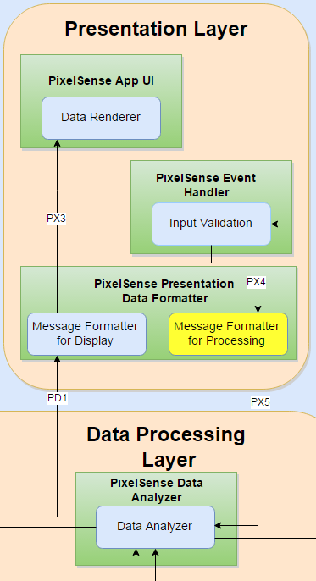
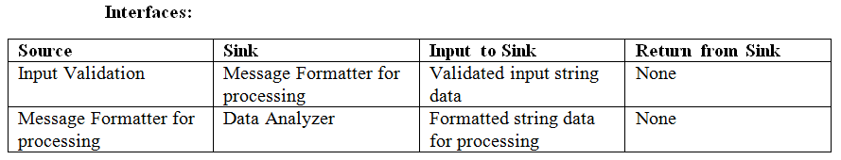
PixelSense Super Layer Modules
Presentation Layer
Message Formatter for Processing
Prologue: Message Formatter for Processing module will accept the validated input data from Event Handler subsystem, and it will format the data in such a way that it is ready for further processing. It then forwards formatted data to Data Analyzer for processing.

Slide 27
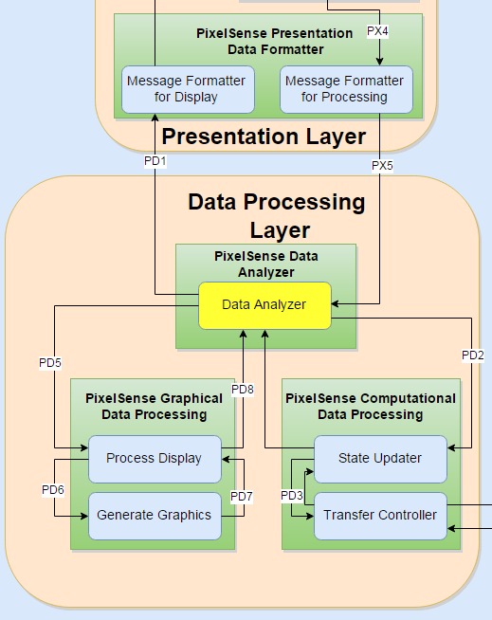
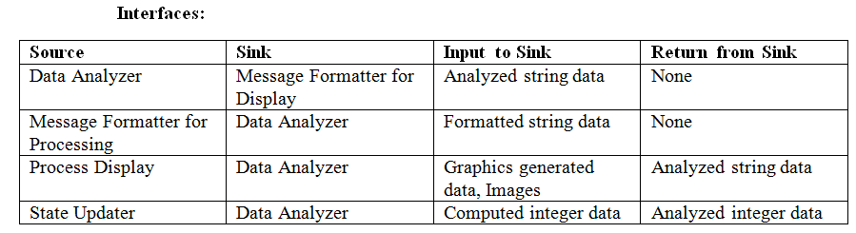
PixelSense Super Layer Modules
Data Processing Layer
Data Analyzer
Prologue: Data Analyzer module interacts with Presentation layer. It receives formatted data from processing message formatter module, and identifies graphical and computational data. Both forms of data are then transferred to graphical and computational data formatter respectively. This module also sends back analyzed data to message formatter for display purposes.

Slide 28
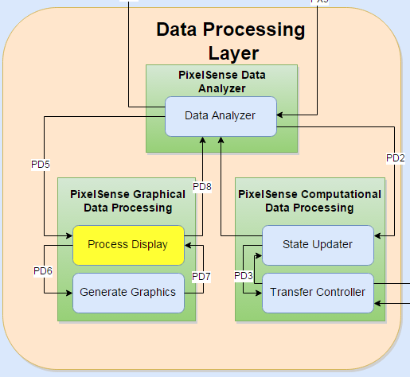
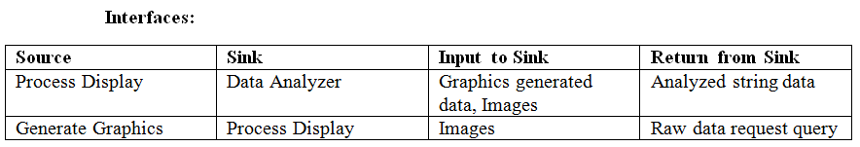
PixelSense Super Layer Modules
Data Processing Layer
Process Display
Prologue: Process Display module accepts graphical data from data analyzer module, and uses that data to create graphical content using graphics generator module.

Slide 29
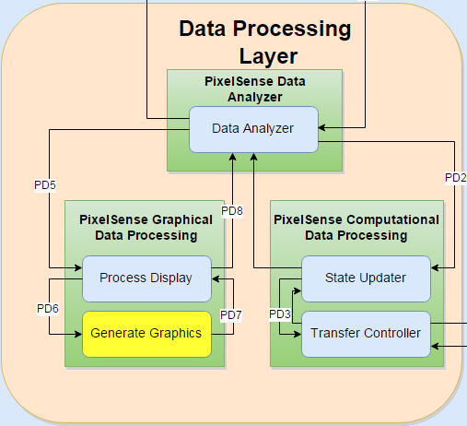
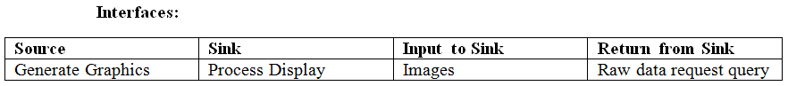
PixelSense Super Layer Modules
Data Processing Layer
Generate graphics
Prologue: Generate Graphics module is responsible for generating game related graphics using the graphical content like card faces, table cloth, chips, images, etc.

Slide 30
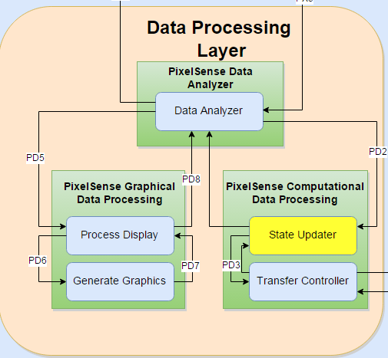
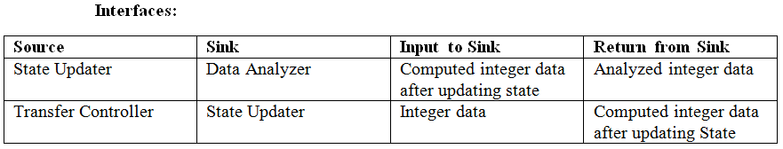
PixelSense Super Layer Modules
Data Processing Layer
State updater
Prologue: This module updates the state of input from the data analyzer, and makes it ready for the transfer controller to forward it to SDK layer. Data passed to this module is computational and no graphics are involved.

Slide 31
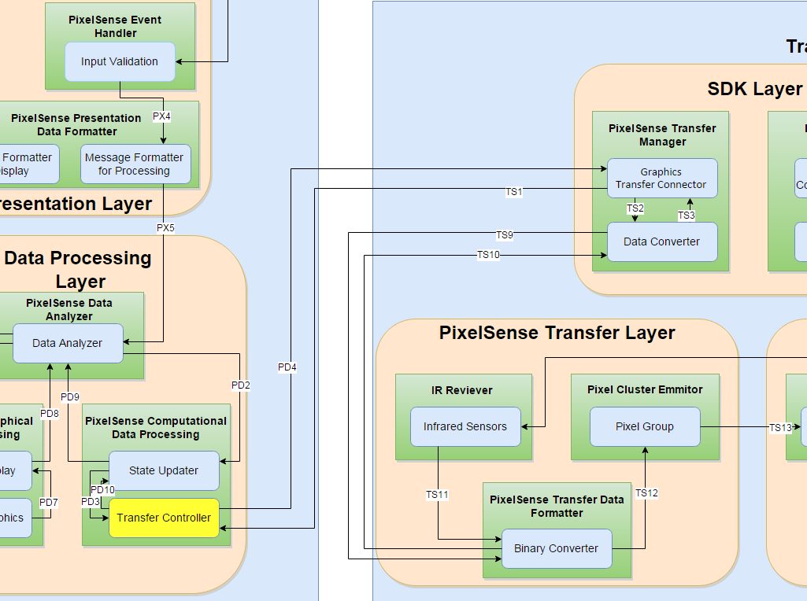
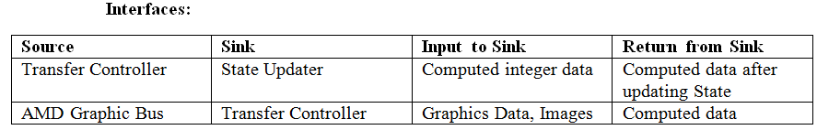
PixelSense Super Layer Modules
Data Processing Layer
Transfer Controller
Prologue: This module is responsible for transferring computational data to the AMD Graphic Bus inside SDK layer. This module also accepts the data coming from Lynx device and forwards it to State Updater for processing.

Slide 32
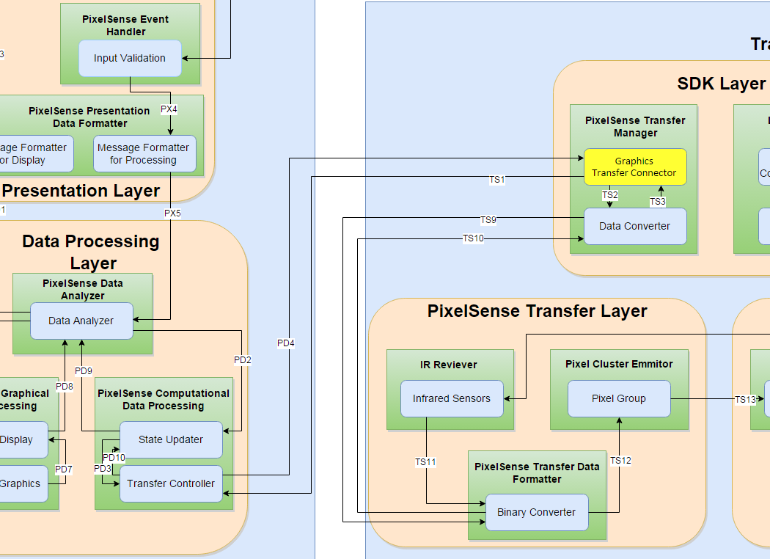
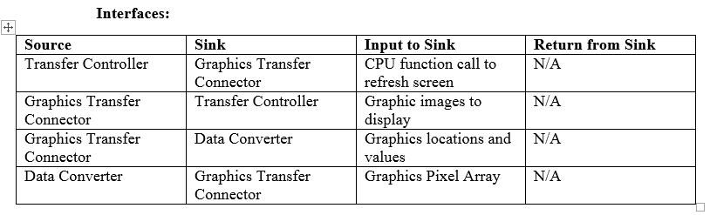
Transfer Super Layer Modules
SDK Layer
Graphics Transfer Module
Prologue: The Graphics Transfer Module will listen for data from the CPU and pass that data to the Graphics processor to be converted to graphical arrays. The transfer module will also transfers data the other way and listens for touch and Infrared input from the graphics processor and transfers it to the CPU for further processing.

Slide 33
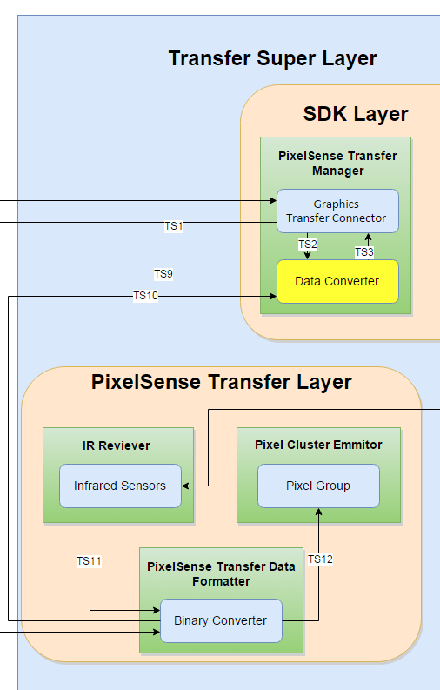
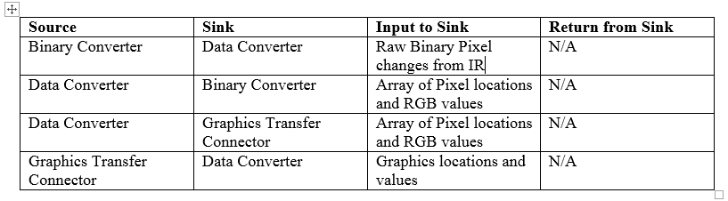
Transfer Super Layer Modules
SDK Layer
Data Converter
Prologue: The Data converter will listen for from the Graphics Bus and convert it into graphical information such as pixel location and pixel values (pixel flashing). The data converter also converts the detected information from the infrared sensors and detects the state (received or not) of those certain locations that we predefine.

Slide 34
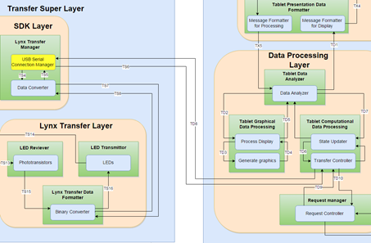
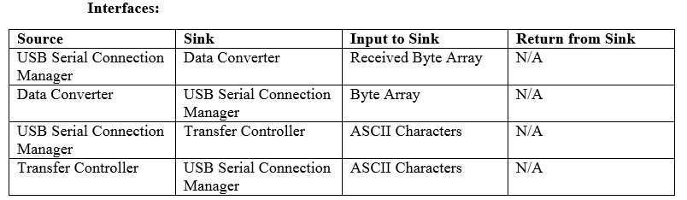
Transfer Super Layer Modules
SDK Layer
USB Serial Connection Manager
Prologue: The USB Serial Connection Manager will listen for data from the Android tablet and pass that data to the Arduino microprocessor to convert it into a sequence for transmission. The Manager also transfers data the other way and listens for state changes from the phototransistor and passes it back to the Android Tablet.

Slide 35
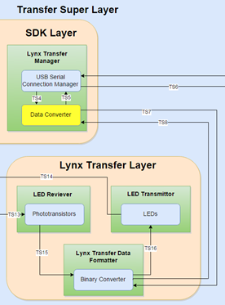
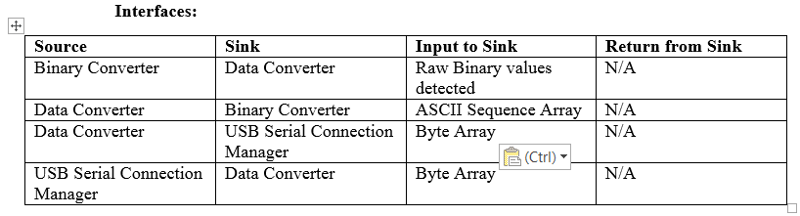
Transfer Super Layer Modules
SDK Layer
Data Converter
Prologue: The Data converter will listen for data from the USB Serial Connection Manager and convert it readable data. The data converter also converts the detected information from the photo transistors and detects the state (received or not) of those certain locations that we predefine.

Slide 36
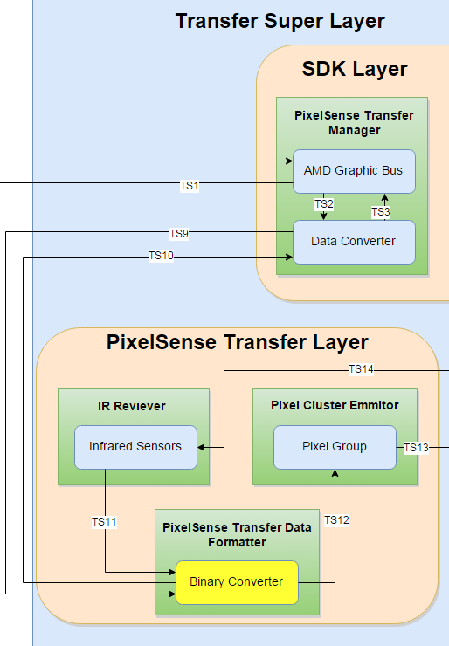
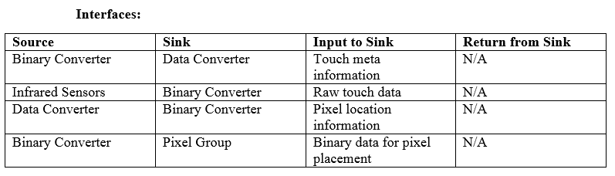
Transfer Super Layer Modules
PixelSense Transfer Layer
Binary Converter
Prologue: The purpose of this module is to convert the data coming in and out to binary or from binary. This module will be the final module between the hardware receiving and transmitting modules so it will end up formatting the data so that either the Pixel Group or the data converter will understand properly.

Slide 37
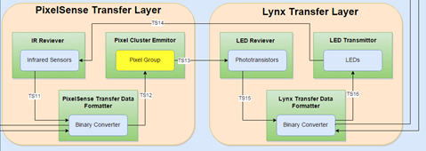
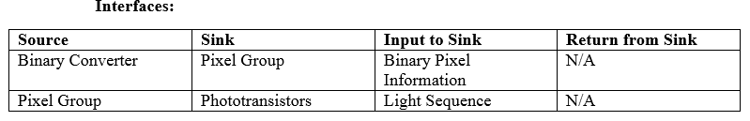
Transfer Super Layer Modules
PixelSense Transfer Layer
Pixel Group
Prologue: This module will flash a group of pixels in a sequence that the Lynx device will understand. It will get a certain sequence from the Binary converter and execute it so that the Pixel Group will flash in a way that the phototransistors will be able to detect.

Slide 38
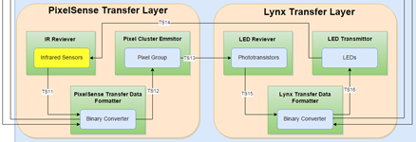
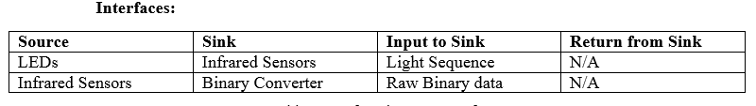
Transfer Super Layer Modules
PixelSense Transfer Layer
Infrared Sensor
Prologue: The infrared sensor will detect the LEDs from the transmitter so that data can be transferred over. It will take the raw input (location and sequence) and pass it on to the Binary Converter for further formatting so the data can be understood than just being on or off states.

Slide 39
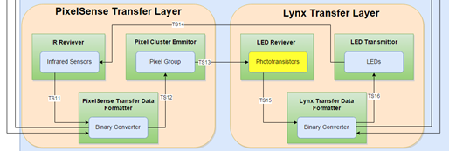
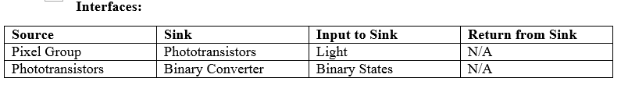
Transfer Super Layer Modules
Lynx Transfer Layer
Phototransistors
Prologue: This module is responsible for detecting light changes and it will then transmit the detected state (on or off) to the binary converter. The module has no other job and will only function has a receiving end of the data transfer process.

Slide 40
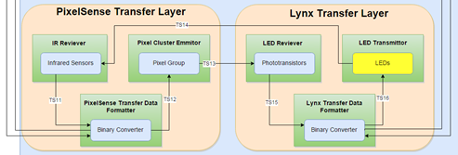

Transfer Super Layer Modules
Lynx Transfer Layer
LEDs
Prologue: This module is an array of LEDs which will flash in a certain binary sequence provided by the Binary Converter. So once it receives certain values it will flash our array in an 8-bit sequence with a small delay in the middle to distinguish different letters and numbers.

Slide 41


Transfer Super Layer Modules
Lynx Transfer Layer
Binary Converter
Prologue: The purpose of this module is to convert the data coming in and out to binary or from binary. This module will be the final module between the hardware receiving and transmitting modules so it will end up formatting the data so that either the Pixel Group or the data converter will understand properly.

Slide 42

Tablet/Lynx Super Layer Modules
Presentation Layer
Data Renderer
Displays to the user:
Data currently on Lynx
Application specific buttons (Hit, Stay, Bet)
Transaction Log
Source | Sink | Input to Sink | Return from Sink
Tablet Data Renderer | User | Display | None
Message Formatter for Display | Tablet Data Renderer | User Event | None

Slide 43

Tablet/Lynx Super Layer Modules
Presentation Layer
Input Validation
Takes the user’s input
Passes input along to be processed
Source | Sink | Input to Sink | Return from Sink
User | Input Validation | User input (String, int) | None
Input Validation | Message Formatter for Processing | Event ID (int) | None

Slide 44

Tablet/Lynx Super Layer Modules
Presentation Layer
Message Formatter for Display
Formats data received from Data Analyzer
Passes formatted data on to Data Renderer to be displayed to the user
Source | Sink | Input to Sink | Return from Sink
Tablet Data Formatter for Display | Data Renderer | Android Event | None
Tablet Data Analyzer | Tablet Data Formatter for Display | Data for new display (Android Event) | None

Slide 45

Tablet/Lynx Super Layer Modules
Presentation Layer
Message Formatter for Processing
Formats data received from Input Validation
Passes formatted data on to Data Analyzer
Source | Sink | Input to Sink | Return from Sink
Tablet Data Formatter for Processing | Tablet Data Analyzer | Formatted User input (String, int) | None
Input Validation | Tablet Data Formatter for Processing | User input (String, int) | None

Slide 46

Tablet/Lynx Super Layer Modules
Data Processing Layer
Data Analyzer
Determines type of incoming data to be processed
Combines processed data to be sent to Presentation Layer
Source | Sink | Input to Sink | Return from Sink
Tablet Data Analyzer | Message Formatter for Display | Processed android event (Android Event) | None
Tablet Data Analyzer | State Updater | Next state in application (String) | None
Tablet Data Analyzer | Process Display | Formatted Android Event (Android Event) | None
Process Display | Tablet Data Analyzer | Android Event | None
Message Formatter for Processing | Tablet Data Analyzer | Formatted Android Event (Android Event) | None

Slide 47

Tablet/Lynx Super Layer Modules
Data Processing Layer
Process Display
Processes incoming data for new display
Passes on graphic id if graphics need to be generated
Passes processed data (display) to Data Analyzer
Source | Sink | Input to Sink | Return from Sink
Process Display | Generate Graphics | Graphic ID | None
Process Display | Data Analyzer | Android Display (Android Activity) | None
Data Analyzer | Process Display | Formatted data for graphical processing (Android Activity) | None
Generate Graphics | Process Display | Graphic (e.g. playing card) | None

Slide 48

Tablet/Lynx Super Layer Modules
Data Processing Layer
Generate Graphics
Generates graphics for application (playing cards)
Passes requested graphic to Process Display
Source | Sink | Input to Sink | Return from Sink
Process Display | Generate Graphics | Graphic id | None
Generate Graphics | Process display | Graphic, image | none

Slide 49

Tablet/Lynx Super Layer Modules
Data Processing Layer
State Updater
Updates state of the application
Processes data received from Data Analyzer
Passes data to be transferred to Transfer Controller
Source | Sink | Input to Sink | Return from Sink
State updater | Transfer Controller | Processed data to transfer (String, int) | None
Data Analyzer | State Updater | Data to be processed (String, int) | None
State Updater | Data Analyzer | Processed data (String, int) | None

Slide 50
Tablet/Lynx Super Layer Modules
Data Processing Layer
Transfer Controller
Transfers data to be sent to PixelSense to USB Serial Connection Manager
Receives data from PixelSense via USB Serial Connection Manager
Makes requests to store and retrieve data via Request Controller
Source | Sink | Input to Sink | Return from Sink
Transfer Controller | USB Serial Connection Manager | Data to be transferred (String, int) | None
Transfer Controller | State Updater | Processed data (String, int) | None
Transfer Controller | Request Controller | Request to store/retrieve data (String) | None
USB Serial Connection Manager | Transfer Controller | Transferred data (String, int) | None
State Updater | Transfer Controller | Data to be transferred (String, int) | None
Request Controller | Transfer Controller | Retrieved data (String, int) | None

Slide 51

Tablet/Lynx Super Layer Modules
Data Processing Layer
Request Controller
Handles Requests to store and retrieve data in database
Passes retrieved data onto Transfer Controller
Source | Sink | Input to Sink | Return from Sink
Request Controller | Convert to Query | Request (String) | None
Request Controller | Transfer Controller | Request (String) | None
Convert to Data | Request Controller | Requested data(String) | None
Transfer Controller | Request Controller | Requested data(String) | None

Slide 52

Tablet/Lynx Super Layer Modules
Data Storage Layer
Convert to Query
Converts a request to store or retrieve data into an SQLite query
Passes queries onto Database Manager to be executed
Source | Sink | Input to Sink | Return from Sink
Request Controller | Convert to Query | Request to store/retrieve (String) | None
Convert to Query | Database Manager | SQLite Query | None

Slide 53

Tablet/Lynx Super Layer Modules
Data Storage Layer
Convert to Data
Takes result from executed query from Database Manager
Converts resulting value into usable data
Passes converted data onto the Request Controller
Source | Sink | Input to Sink | Return from Sink
Database Manager | Convert to Data | Result of query (ResultSet) | None
Convert to Data | Request Controller | Requested data | None

Slide 54

Tablet/Lynx Super Layer Modules
Data Storage Layer
Database Manager
Takes SQLite query from Convert to Query
Connects to SQLite database
Executes query
Sends result of query to Convert to Data
Source | Sink | Input to Sink | Return from Sink
Database Manager | Convert to Data | Result from query (ResultSet) | None
Database Manager | SQLite Database | Query (String) | None
Convert to Query | Database Manager | SQLite query | None
SQLite Database | Database Manager | Result from query (ResultSet) | None

Slide 55
Quality Assurance
Testing along the two-way data pipeline
Incorporates two reusable testing modules: DataEmulator and DataLogger
Generic Types
Plug-in Ideology
Test Cases: different batches of emulated input, inspection of logged output
Larger Grain Testing uses the same process. Modules form a chain of test module calls. System Verification achieved through general playtesting and Specific Use-Cases
Test Case | Expected Result
A Player can join a game of Black Jack | A Player is authenticated by the system, and relevant player data is transferred to the table.
A Player can play a round of Black Jack | A Player plays through a game of BlackJack, with inputs being sent the table, and receiving data output updates to chip count
A Player can leave the table | A Player disconnects his/her device, retaining the accurate state from the table, without data corruption

Slide 56

Requirements Mapping

Slide 57
Acceptance Plan
Deliverable Product:
Lynx hardware (pre-assembled)
Micro USB to OTG adaptor
USB cord
Android tablet
USB stick with android test software
Surface test software
Transfer SDK

Slide 58
Acceptance Plan
Acceptance Criteria | Requirements fulfilled
The device can securely transfer information using an array of sensors | 3.1, 4.7, 4.8
The device can securely receive information using an array of sensors | 3.2, 4.7, 4.8
An SDK is provided and used to program for the device created | 3.3, 4.1
The transfer rate of the Lynx is at least 200 bits/sec | 5.1
The Lynx has a port that can be used to connect to a table | 3.4
The software is provided for the PixelSense table that demonstrates the connection between the Lynx and the table | 3.7
Software developed for the PixelSense can detect the orientation of Lynx | 4.9, 4.10, 4.11

Slide 59

Questions?

